Slide 1




Financial Wellbeing with BrightPlan
BrightPlan is Optum’s partner for offering financial wellbeing services. As part of the EAP services offered through Optum, UHG employees access localized financial resources.
Financial Wellbeing (included)
  Resources include the financial health check, articles, videos, checklists, and more and are accessed via Optum’s platform. (Live today for Global, launching January 1, 2025 for the US)
Money Coaches (included in the US)
  US-based members access live Money Coaches to support financial needs of members and their families (Launching January 1, 2025)
Financial Wellness Buy-Up (add-on in the US and globally)
  Optum provides additional opportunities to expand financial wellbeing support through BrightPlan at discounted rates including webinars and unlimited live coaching.
+
© 2024 BrightPlan and/or its affiliates. All rights reserved. BrightPlan Confidential

Slide 2
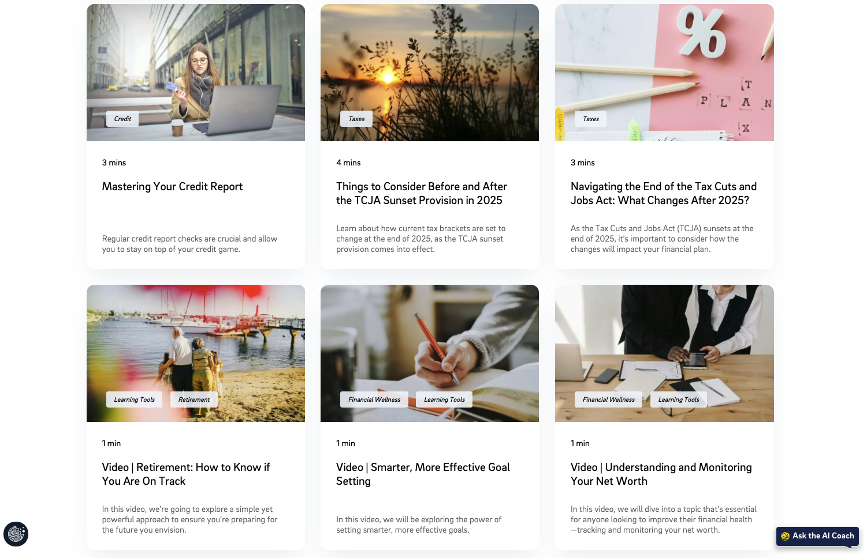
Included in Optum’s Employee Assistance Program
Financial Wellbeing
Powered by BrightPlan
Robust educational library available 24/7
Localized and translated (global) resources
Multimedia resources and interactive tools
Available to all members and their families
Resources covering various topics: budgeting, life events, financial health, taxes, retirement, & more
Coaching Calls 2x per incident for US-based members
+
© 2024 BrightPlan and/or its affiliates. All rights reserved. BrightPlan Confidential

Slide 3
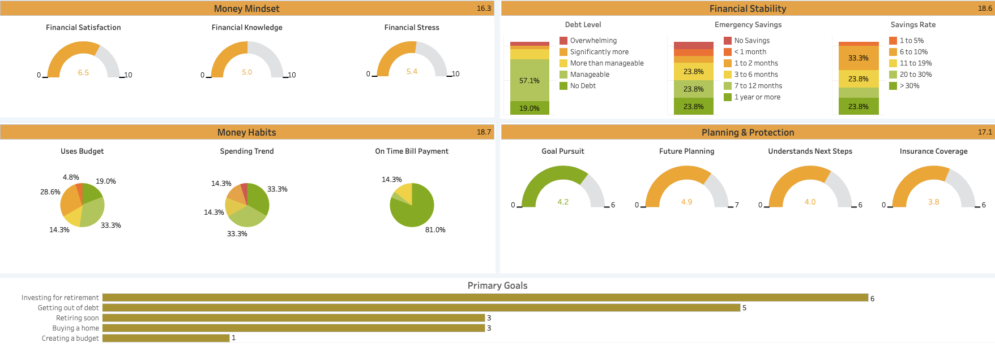
Sample Reporting: Financial Health Check

Slide 4
+
Buy Up Opportunity

Slide 5
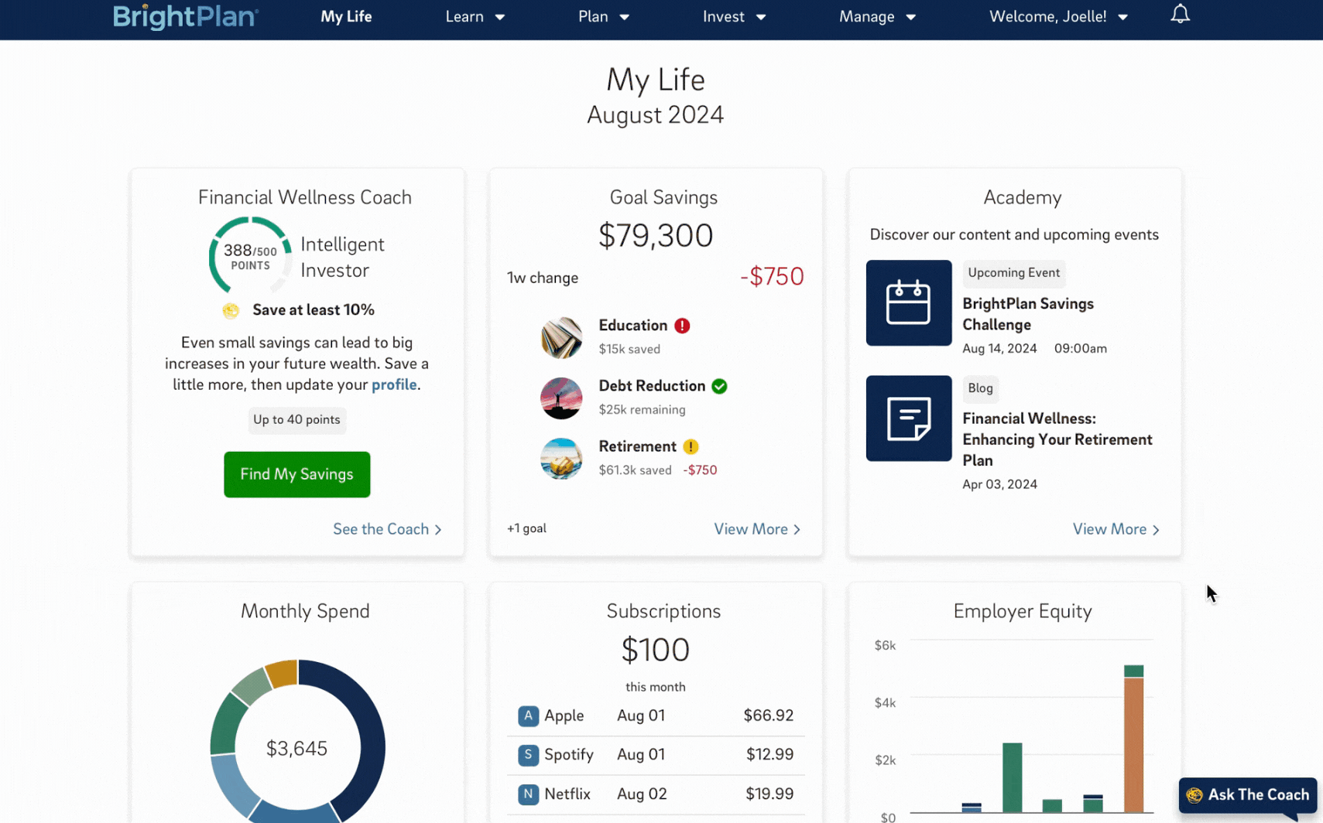
Financial Wellbeing Buy Up
Unlimited access to CFP® advisors trained in UHG’s benefits
Digital Financial Wellness Coach™ trained in UHG benefits
Equity Compensation Planner tailored to UHG benefits (enabled where applicable)
Robust In-App Features and Functionality*
  BrightPlan Academy tailored to the company’s benefits
  Goals-Based Financial Planning
  Investment & 401(k) allocation advice (US Only)
  Spending Analysis for linked accounts
  Net Worth and Goal Status Tracking, Dynamic Balance Sheet, and Budgeting
Referrals to Estate Planning and Tax Preparation Services
Reporting and metrics on engagement and key care abouts via QBR and Data Portal
Tailored communication and engagement support (monthly collateral)
+
© 2024 BrightPlan and/or its affiliates. All rights reserved. BrightPlan Confidential

Slide 6





When it comes to finances, everyone needs help sometimes.
Our BrightPlan Certified Financial Planners (CFPs®) create a judgment-free, confidential space to get support, ask questions, and take steps toward financial well-being—because everyone deserves to know they can ask for help.
FIND SUPPORT
ASK QUESTIONS
MOVE FORWARD
Smart Strategies to Make Ends Meet
and Manage Debt
Feeling stuck in a paycheck-to-paycheck cycle? A CFP® helps break the cycle by prioritizing expenses, negotiating with creditors, and creating a realistic repayment plan to reduce stress and regain control.
Personalized Financial Answers
Just for You
A CFP® creates a personalized plan to guide you in managing your money and reducing financial stress, tailored to your unique income, expenses, and challenges.
Building Confidence in Your
Financial Future
A CFP® provides tools to help you manage your budget, build savings, and set financial goals, empowering you to break the paycheck-to-paycheck cycle and focus on what truly matters in life.

Slide 7





“Great discussion and conversation. I am planning to schedule another call to focus on my expenses.”
- BrightPlan User
Client Testimonials
BrightPlan took our financial wellness offering to the next level and helped us empower our associates to bring their best selves to work.
- BrightPlan Customer, Bread Financial
“BrightPlan partners closely with our ERG’s to help all employees maximize the value of their benefits and to reach our DE&I goals.”
- BrightPlan Customer, Salesforce
+
© 2024 BrightPlan and/or its affiliates. All rights reserved. BrightPlan Confidential

Slide 8
+
brightplan.com

Slide 9
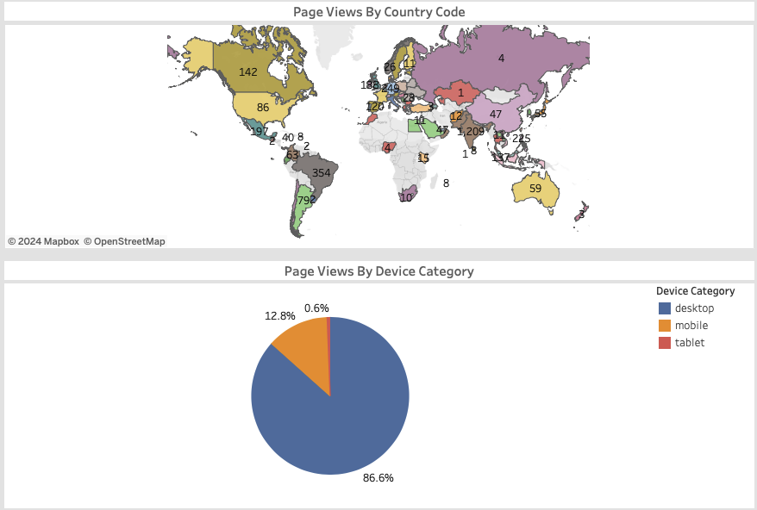
Sample Reporting: Page Activity

Slide 10
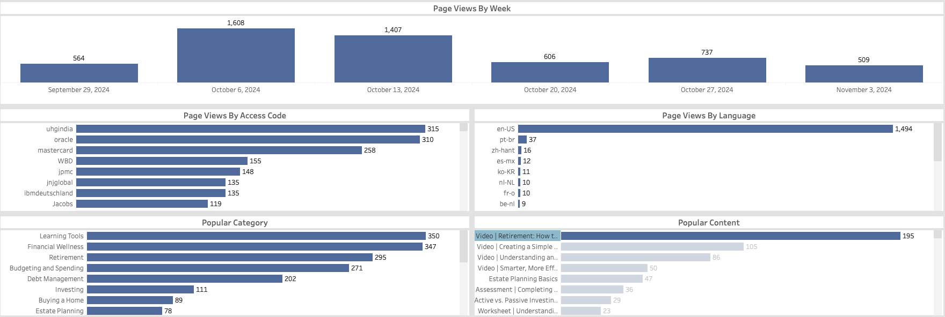
Sample Reporting: Page Activity

Slide 11
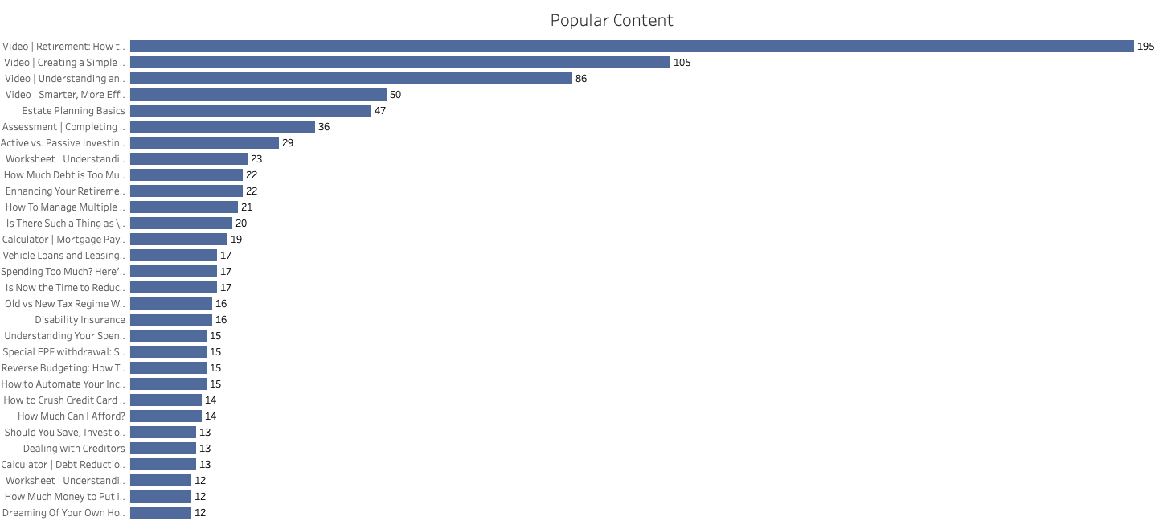

Slide 12
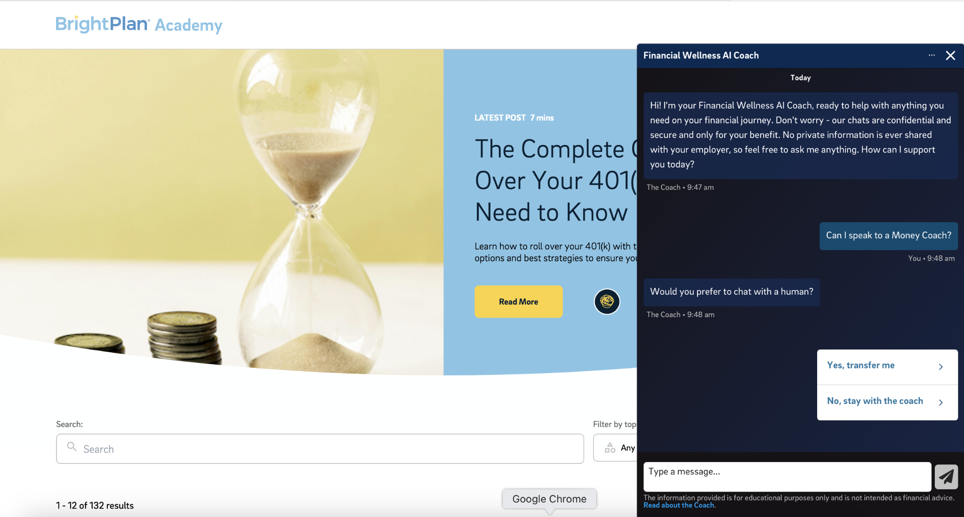

Slide 13
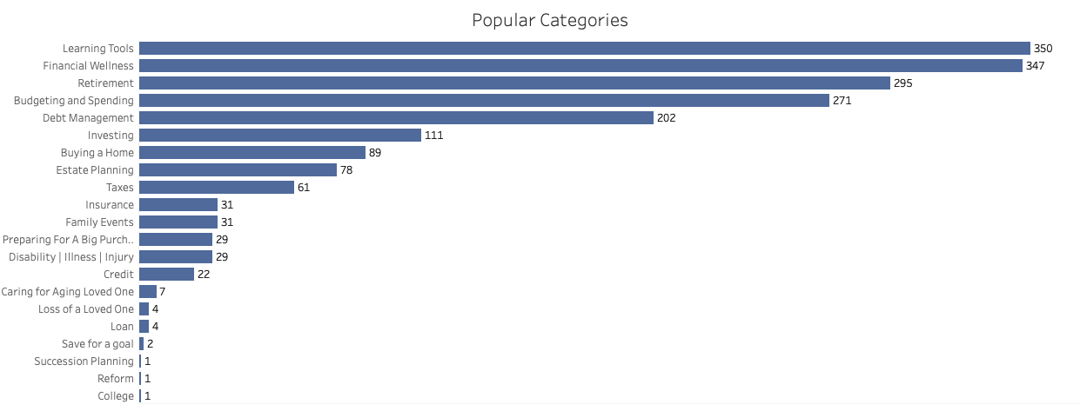

Slide 14

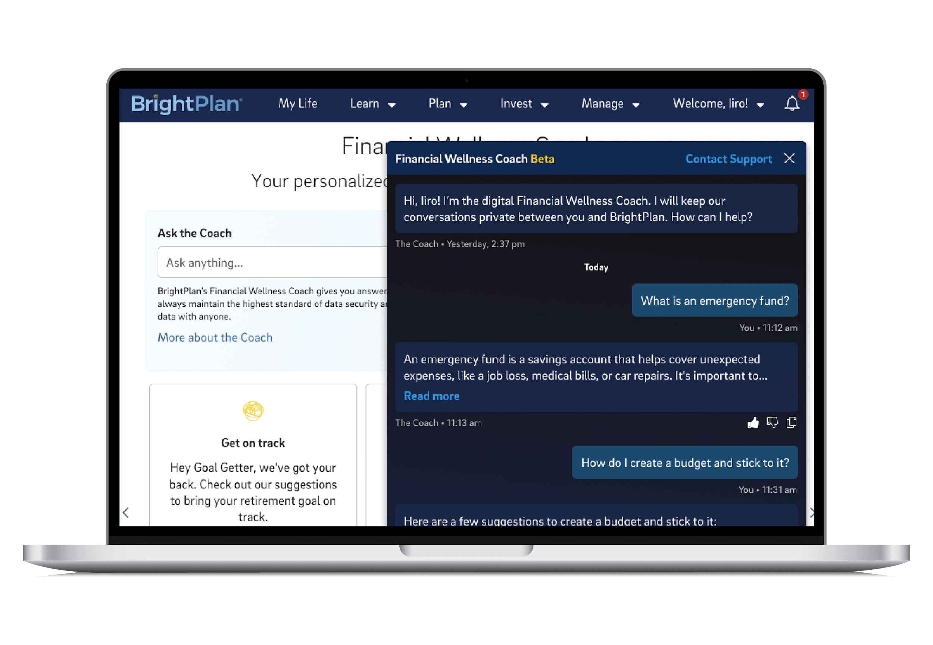
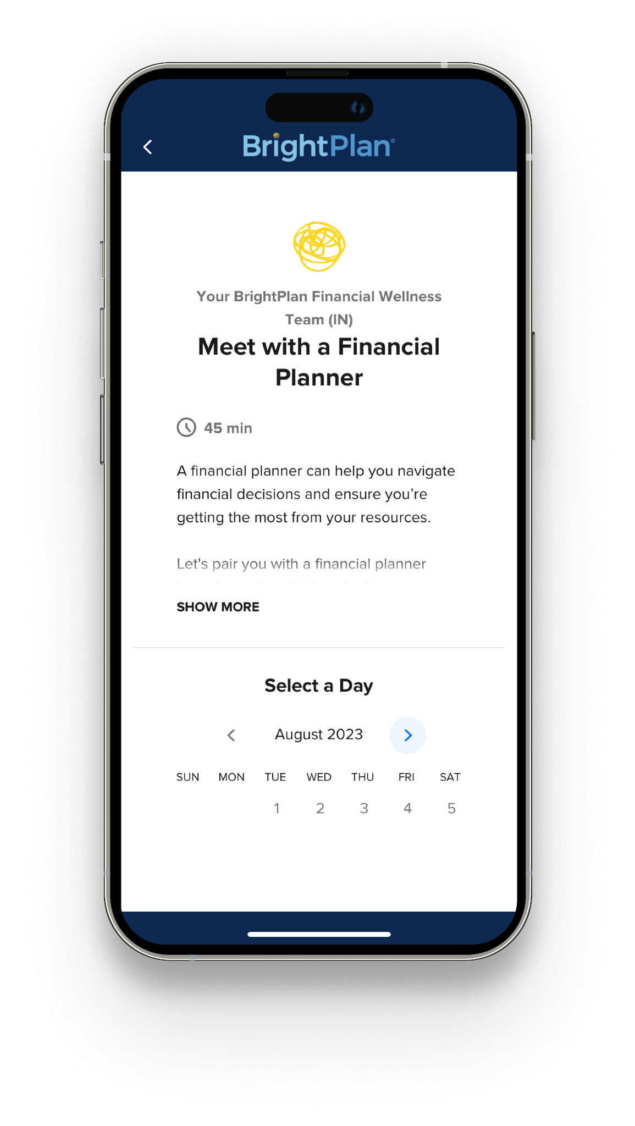
Global Buy-Up: Digital
& Live Money Coaches
Real-time, customized support, wherever your employees are.
Financial Wellness AI Coach
  Interactive and responsive support enhances benefits engagement through financial wellness resources.
  Reduce HR caseload by handling inquiries on Financial Guidance, Open Enrollment, HR-services etc.
  Gain understanding to employee’s needs that deliver insights into what drives productivity and wellbeing
Live Money Coaches
  In-country experts who provide support and guidance to local members
  Trained in company benefits to drive engagement and strong decision making
  Unlimited access to live support for members and their households
+
© 2024 BrightPlan and/or its affiliates. All rights reserved. BrightPlan Confidential

Slide 15
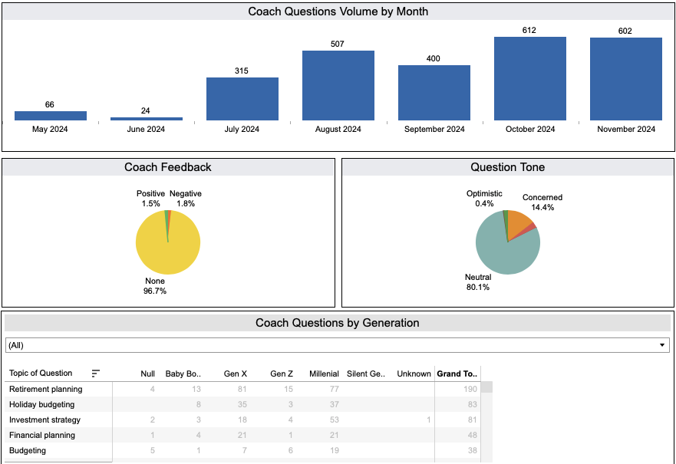
Sample Reporting: AI Coach Interactions

Slide 16
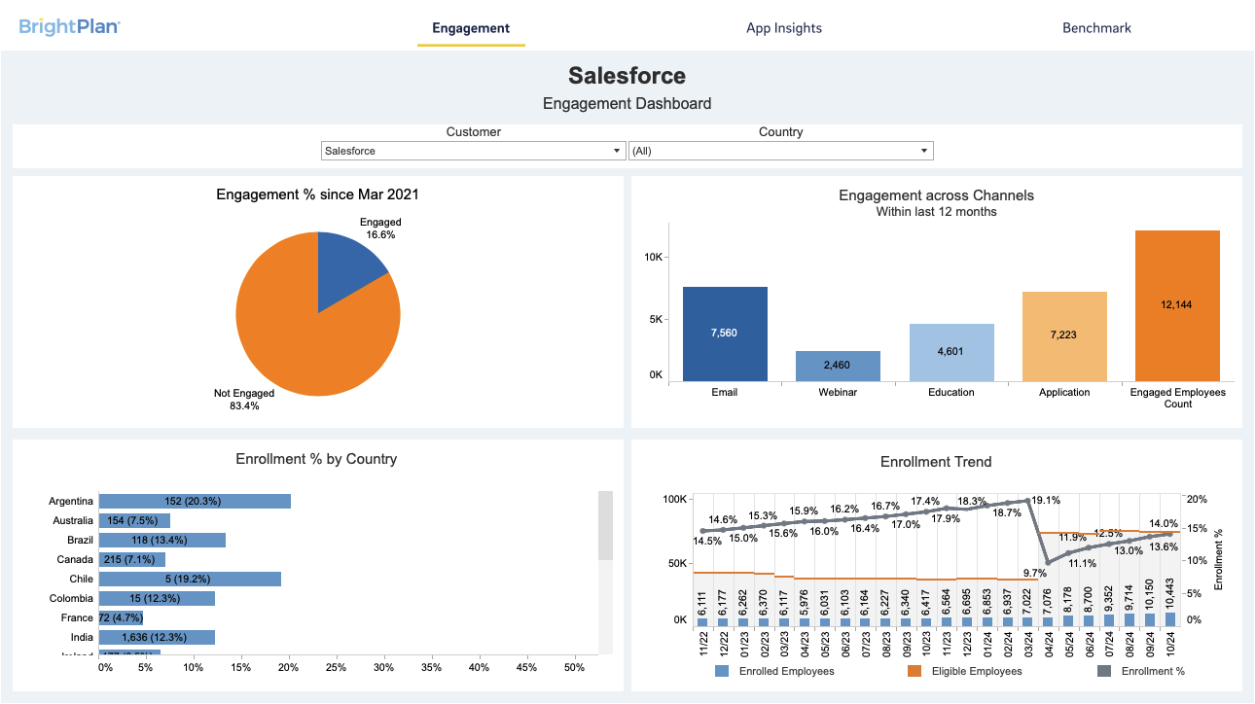
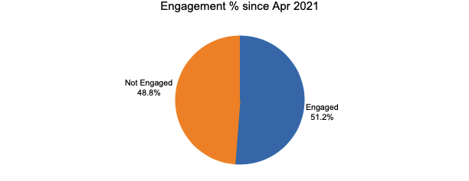
Sample Reporting: Engagement Dashboard

Slide 17
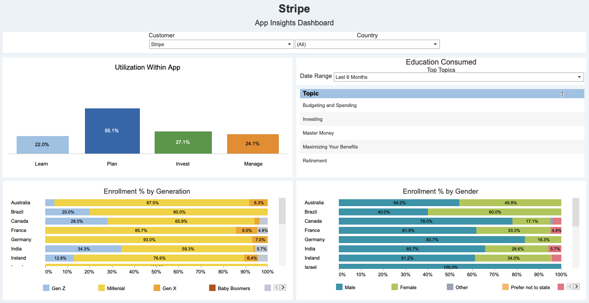
Sample Reporting: App Insights

Slide 18
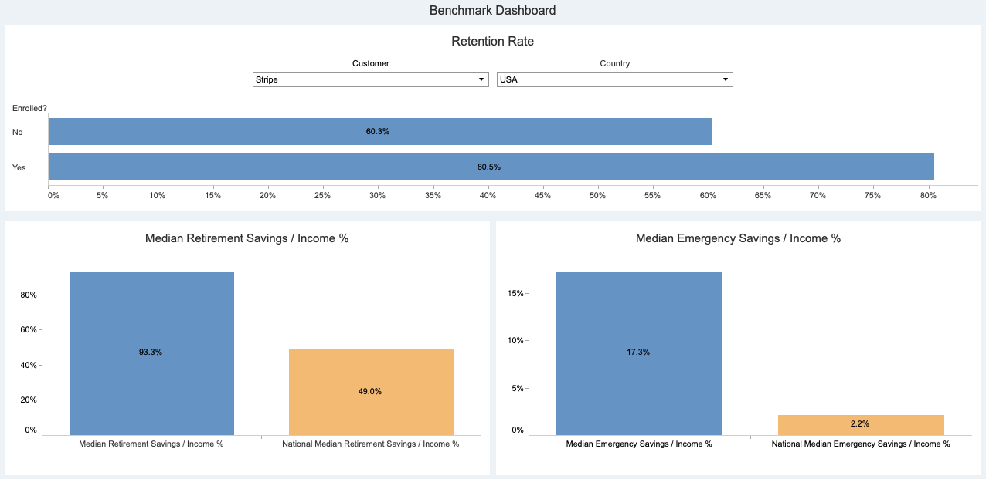
Sample Reporting: Retention and Benchmarks

Slide 19
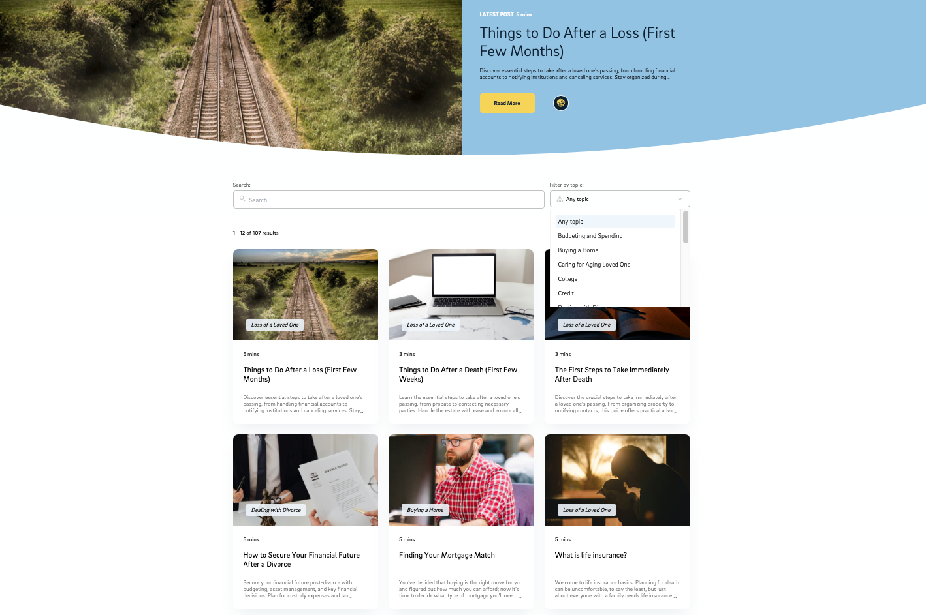
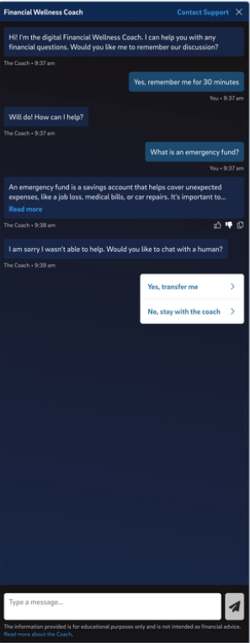
Get Started

Slide 20
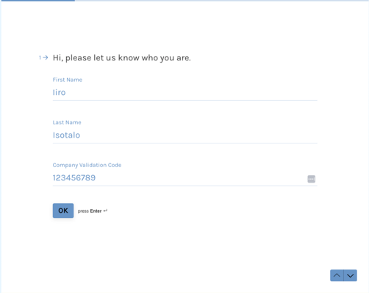
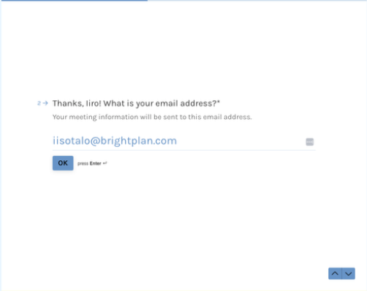
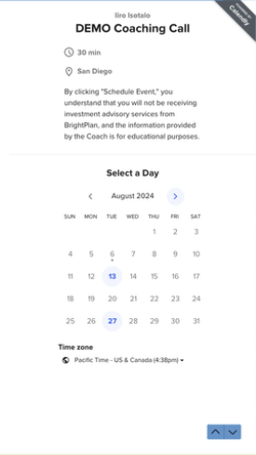
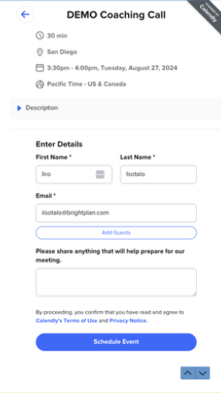
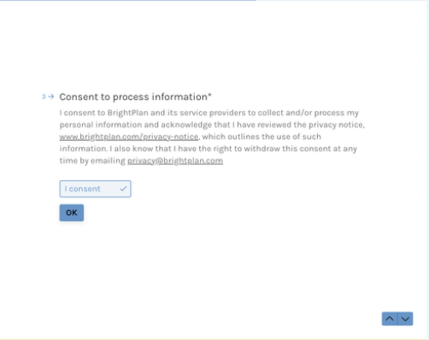
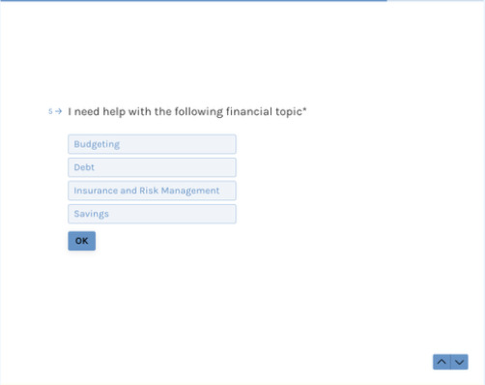
1
2
Advisor Call Scheduling
5
6
3
4

